Slide 1
Propositional Logic

Slide 2
Logic is the study of reasoning. The British mathematician George Boole (1815-1864) is the man who made logic mathematical. Logic can be used in programming and it be applied to the analysis and automation of reasoning about software and hardware. This is why it is considered a part of theoretical computer science. Since reasoning plays an important role in intelligent behaviour, logic is closely related to artificial intelligence.

Slide 3
In logic and in linguistics, we distinguish between 2 languages: the one that is the object of study and the one that we use to talk about that object. The former is called the object language; the latter is the metalanguage. The object language is the formal language of propositional formulas. The metalanguage is the usual informal language of mathematics and theoretical computer science, which is a mixture of the English language and mathematical notation.

Slide 4
An assertion is a statement
A proposition is an assertion which is either true or false but not both.
The following are propositions
4 is a prime number
3 + 3 = 6
The moon is made of cheese.

Slide 5
The following are not propositions
X + Y > 4
X = 3
Are you leaving?
Buy four books

Slide 6
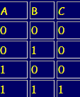
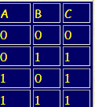
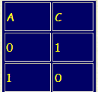
Recall Boolean Algebra (Truth Tables)
A logical table of a combinatorial circuit lists all possible inputs together with the resulting outputs. Below are the logical tables for the basic AND, OR and NOT circuits.
NOT gate
AND gate
OR gate

Slide 7
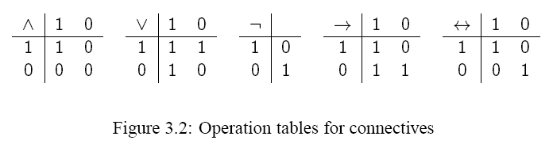
A Boolean value, also called a truth value, is either 0 or 1. An interpretation for a set of boolean variables, P is a mapping from P to the set of boolean values {1,0}.

Slide 8
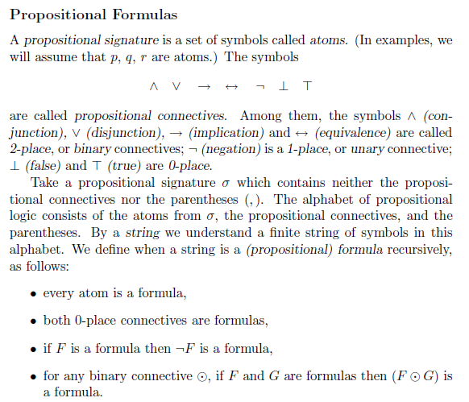
Syntax & Semantics of Propositional Formulas

Slide 9
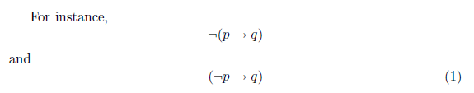
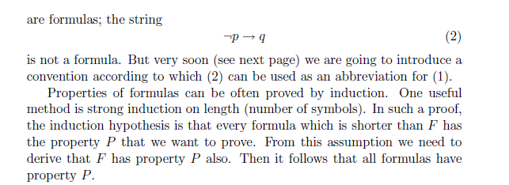

Slide 10
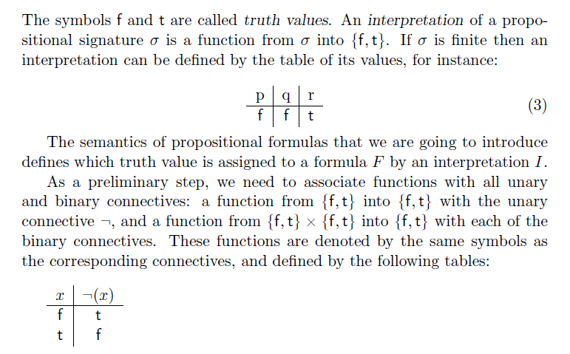
Semantics of Propositional Formulas

Slide 11
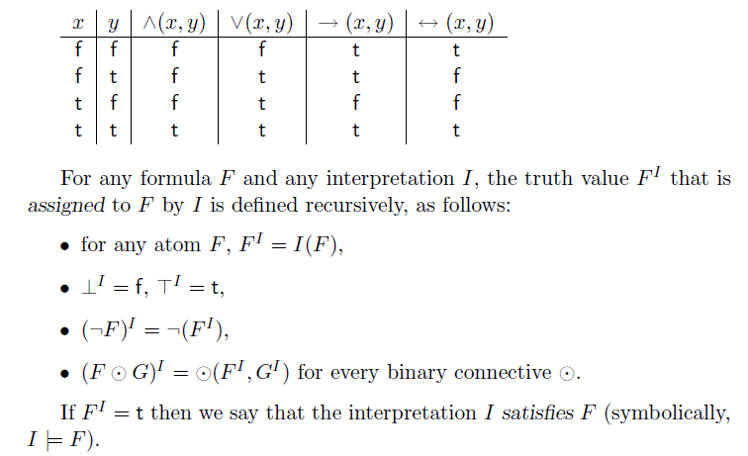

Slide 12
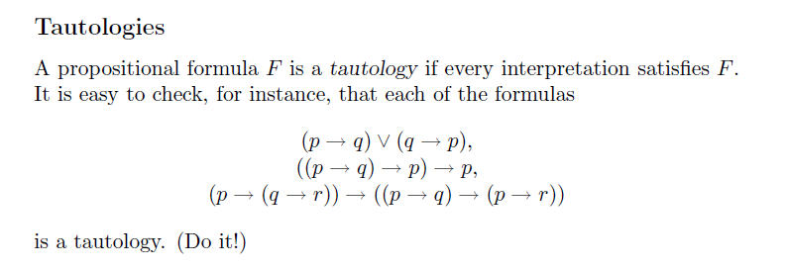

Slide 13
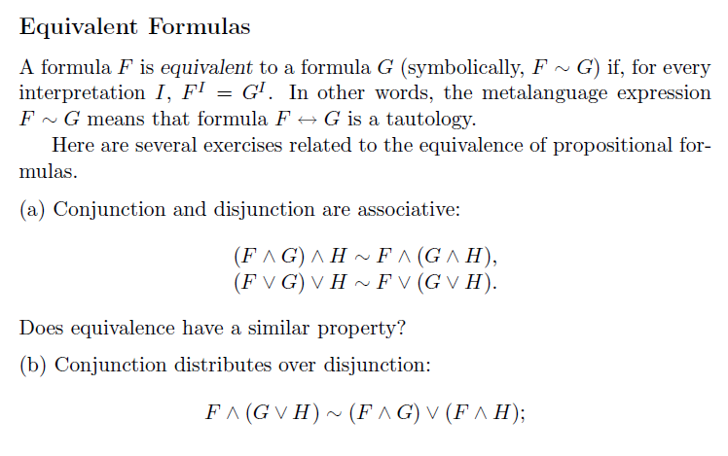
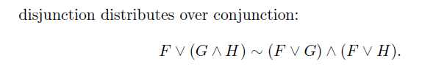

Slide 14
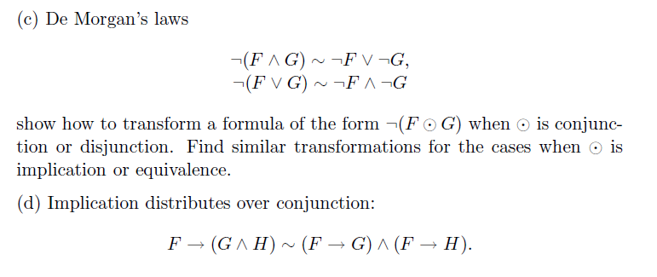

Slide 15
Exercises
Use a truth table to verify that the following are equivalent formulas:
F ⋀ (G ⋁ H) ∼(F ⋀ G) ⋁ (F ⋀ H)
F ⋁ (G ⋀ H) ∼(F ⋁ G) ⋀ (F ⋁ H)
De Morgan's Law
3. ⅂ (F ⋀ G) ∼ ⅂F ⋁ ⅂G
4. ⅂ (F ⋁ G) ∼ ⅂F ⋀ ⅂G

Slide 16
(1)
F ⋀ (G ⋁ H) ∼(F ⋀ G) ⋁ (F ⋀ H)
F | G | H | (G ⋁ H) | F⋀(G ⋁ H) | (F ⋀G) | (F ⋀H) | (F ⋀G)⋁(F ⋀H)
F | F | F | F | F | F | F | F
F | F | T | T | F | F | F | F
F | T | F | T | F | F | F | F
F | T | T | T | F | F | F | F
T | F | F | F | F | F | F | F
T | F | T | T | T | F | T | T
T | T | F | T | T | T | F | T
T | T | T | T | T | T | T | T

Slide 17
(2)
F ⋁ (G ⋀ H) ∼(F ⋁ G) ⋀ (F ⋁ H)
F | G | H | (G ⋀H) | F⋁(G ⋀H) | (F ⋁G) | (F ⋁H) | (F ⋁G)⋀(F ⋁H)
F | F | F | F | F | F | F | F
F | F | T | F | F | F | T | F
F | T | F | F | F | T | F | F
F | T | T | T | T | T | T | T
T | F | F | F | T | T | T | T
T | F | T | F | T | T | T | T
T | T | F | F | T | T | T | T
T | T | T | T | T | T | T | T

Slide 18
(3)
⅂ (F ⋀ G) ∼ ⅂F ⋁ ⅂G
F | G | (F ⋀G) | ⅂(F ⋀G) | ⅂F | ⅂G | ⅂F ⋁ ⅂G
F | F | F | T | T | T | T
F | F | F | T | T | T | T
F | T | F | T | T | F | T
F | T | F | T | T | F | T
T | F | F | T | F | T | T
T | F | F | T | F | T | T
T | T | T | F | F | F | F
T | T | T | F | F | F | F

Slide 19
(4)
⅂ (F ⋁ G) ∼ ⅂F ⋀ ⅂G
F | G | (F ⋁G) | ⅂(F ⋁G) | ⅂F | ⅂G | ⅂F ⋁ ⅂G
F | F | F | T | T | T | T
F | F | F | T | T | T | T
F | T | T | F | T | F | F
F | T | T | F | T | F | F
T | F | T | F | F | T | F
T | F | T | F | F | T | F
T | T | T | F | F | F | F
T | T | T | F | F | F | F

